Slide 1


Building and Managing Containers with Azure
Blaize Stewart – Architect
MCSE, PCSA, MVP, and MCT
bstewart@Wintellect.com | @theonemule

Slide 3

Container Workflow
Container Registry
Container Image
FROM alpine
RUN apk update && apk add bash wget
COPY no-ip.sh /no-ip.sh
CMD /bin/bash /no-ip.sh
Container Image
Container Image
Dockerfile
docker build
Container
docker push
deploy
Build Env
Container Env

Slide 4
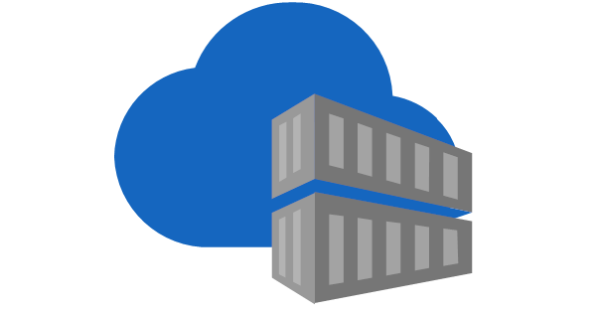
Azure Container Registry (ACR)
Azure Container Registry serves as Microsoft’s first party solution for containers on Azure.
ACR can work with any application that can access Docker containers.
ACR can work with private endpoints and public endpoints.
ACR has built in support for building containers and extensibility with downstream services through webhooks.

Slide 5
Azure Container Registry Tasks
ACR Tasks allow you to trigger container builds inside ACR.
Tasks are useful for working with GitHub repos and Azure DevOps.
Tasks will build and version containers and put them into the respective repository. Build logs and build history are visible through the CLI and Azure Portal.

Slide 6
Azure Container Registry Tasks

Slide 7

GitHub Actions
GitHub Actions automate tasks based on GitHub repositories.
These tasks can build, test, and deploy software to numerous different target environments and workloads.
GitHub Actions use a YAML file as part of the repository to define the pipeline.

Slide 8
GitHub Actions for Building Containers

Slide 9

Azure DevOps
Azure DevOps has the “classic” editor and a newer YAML-based editor for creating build pipelines.
ADO uses separate pipelines for deployments than it uses for builds.
ADO can work with different services, including GitHub, for source files.

Slide 10
Azure DevOps Pipeline for Building Containers

Slide 11
Comparing Build Pipelines
Tech | Advantages | Disadvantages
Azure Container Registry Tasks | Easy to setup and use (no code required) Tight integration with GitHub and Azure DevOps | Use GitHub Personal Access Tokens No built-in CD. Requires a webhook to trigger downstream tasks
GitHub Actions | Easy to integrate with existing and new GitHub repositories Tons of templates built for all kinds of workloads to many different kinds of environments. | No clear distinction between CI and CD pipelines Can only use GitHub repos as a source
Azure DevOps | Supports many different sources like Bitbucket, GitHub, ADO Git, SVN, and others Clear distinction between build (CI) and deployment pipelines | Agents can be slow at times for builds (not recommended for large containers like Windows containers)

